Slide 1
STEPS OF WRITING PROCESS
Department of Computer Science
MCS IV (M)
By
Fouzia Jamal Goreja

Slide 2
INTRODUCTION
Writing is a process/skill (practice)
and is a complex combination of skills which can be broken down into five steps:
prewriting, (Planning)
drafting, (Writing) Ist 2nd 3rd final
revising,
Editing Changes, and proofreading.

Slide 3
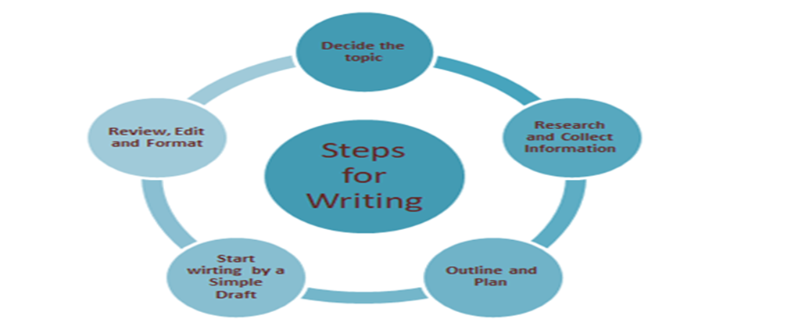
RECURSIVE/REOCCUR linear/process
Notes:
Programming/ movie going resources Web RECURSIVE

Slide 4
PRE Writing(planning)
Prewriting: is the planning phase of the writing process, when students
research, gather information
outline ideas, brainstorm, often using diagrams for mapping out their thoughts /rearrange
make a list, journal write, WH or create a cluster.
TECHNIQUES
Audience and purpose should be considered
Notes:
Programming is the best tevcchnique

Slide 5
Cont..
'What do I want to write about?',
'What do I want to achieve?',
'What personal views do I have?', or
'What do I want my audience to learn?'.

Slide 6
Drafting)
Drafting: Students create their initial composition by writing down all their ideas in an organized way to convey a particular idea or present an argument.
Audience and purpose need to be finalized.
There can be multiple drafts:
first draft, second draft and so on.

Slide 7
(Writing)
Some questions that you can use while writing:
'Are my ideas organized?‘
'Am I sharing strong details?‘/examples
'Should I include more information or take some away?‘/delete
As you write, keep asking yourself questions that will help further develop and support your project.

Slide 8
Revising
Revising:
The goal of this phase of the writing process is to improve the draft.
Students review, modify, and reorganize their work by rearranging, adding, or deleting content, and by making the tone, style, and content appropriate for the intended audience..

Slide 9
How to do revising?
Take some time away from your paper. Set it aside for a few hours or even days. In this way you are starting with fresh eyes. TIME
Print out your paper/hard copy. This way you can take notes as you revise and edit.
Change the format of your paper! It could be a larger, bolder font, which help you in finding errors in your writing.
QUIET Work somewhere without distractions. Turn off the phone and TV.
Just focus on your writing!

Slide 10
EDITING EXAMPLE
At the start of school Dora was afrad of her new Teacher. Mrs. Davis seamed nice, but she had so manny rules for the class to folow. Scare someone to pieces. As the school year cotinued, Dora begun to understan how the Teacher come up with the rules The rules were their so students would be respecful of theyselves and each other. By the end of the year, Dora though Mrs. Davis was the best Teacher she evere had!

Slide 11
CORRECTIONS
At the start of school Dora was afraid of her new teacher. Mrs. Davis seemed nice, but she had so many rules for the class to follow. It would scare someone to pieces. As the school year continued, Dora began to understand how the teacher came up with the rules. The rules were there so students would be respectful of themselves and each other. By the end of the year, Dora thought Mrs. Davis was the best teacher she ever had!

